Slide 1

Presented by: Mouhsine DAOUDA
Predictive Analysis of Academic Performance via Social Media Influence Metrics
Predictive Analysis of Academic Performance via Social Media Influence Metrics

Slide 2

Overview
This capstone project centers on predicting and understanding the academic performance of university students by exploring social media influence factors.
Aligned with Sustainable Development Goal (Quality Education), it addresses the impact of social media on academic outcomes.
The project aims to unravel the correlation between various social media metrics, including time spent, friend count, platform usage, group involvement, and academic success.
By leveraging machine learning, the project aspires to offer actionable insights to enhance educational environments and contribute to the broader goal of improving the quality of education..

Slide 3
1- Concept Note
I- Objectives
The specific objectives of this project are to develop a predictive model that utilizes machine learning techniques to analyze the impact of social media on academic performance.
By identifying key social media influence factors, the project aims to provide actionable recommendations for fostering improved learning outcomes.
The ultimate goal is to contribute to the development of strategies that positively impact students' academic achievements.

Slide 4
II- Background
In the current digital age, social media profoundly influences various aspects of individuals' lives, including academic performance. While existing solutions have explored this relationship, a machine learning approach is crucial for comprehensively analyzing the multifaceted nature of social media metrics. This approach allows for interpretable insights into the nuanced dynamics between social media engagement and academic success, filling a critical gap in understanding.

Slide 5
III- Methodology
The project will follow a two-step methodology. In the first step, the focus is on predicting GPA (a continuous value). Various machine learning algorithms will be explored for regression tasks. The algorithms to be considered include, but are not limited to:
Linear Regression: Suitable for establishing a linear relationship between social media metrics and GPA.
Decision Trees: Effective in capturing non-linear relationships and feature interactions.
Random Forest: An ensemble method that excels in handling complex datasets and providing feature importance insights.
Gradient Boosting: Useful for boosting the predictive accuracy by combining weak learners.
Support Vector Machines (SVM): Beneficial for regression tasks, especially when dealing with high-dimensional data.

Slide 6
III- Methodology
In the second step, a new feature "Performance" will be engineered based on GPA values, categorizing them into high (0), medium (1), and low (2). This transforms the problem into a classification task. For this, classification algorithms will be explored, including:
Logistic Regression: Applicable for binary or multiclass classification tasks.
K-Nearest Neighbors (KNN): Effective in capturing local patterns in the data.
Random Forest Classifier: Extending its application from regression to classification tasks.
Support Vector Machines (SVM): Well-suited for classification tasks, especially when there's a need to handle non-linear decision boundaries.
This two-step approach allows for a comprehensive analysis of social media influence metrics on academic outcomes, exploring both regression and classification perspectives. The selected algorithms provide a diverse set of tools to address the complexity of the relationship between social media engagement and academic performance.

Slide 7
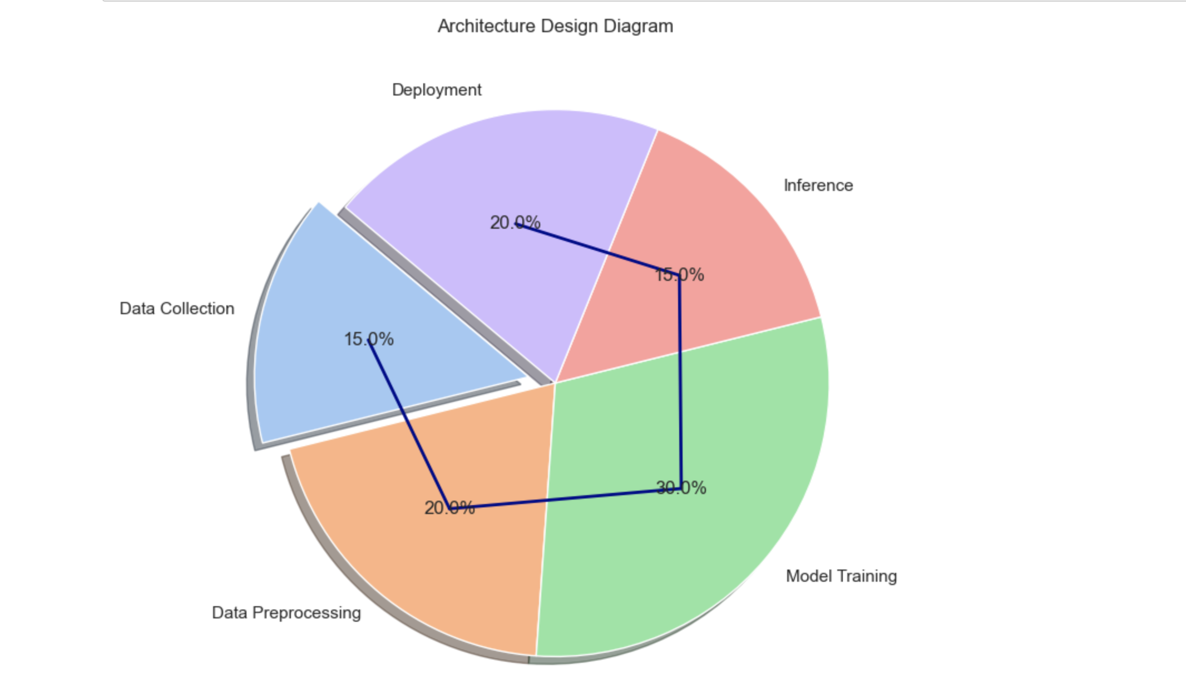
Architecture Design Diagram The architecture comprises data collection from social media and academic sources, a preprocessing module for data optimization, a machine learning model training module, and an inference module for predicting academic performance. Each component interacts to ensure a seamless flow from data input to predictive insights.

Slide 8
IV- DATA SOURCE
UPSA the researchers conducted an online survey using a questionnaire to collect data.
The questionnaire comprised 8 items covering: the number of friends on social media, number of social media groups, number of social media platforms, amount of time spent on social media daily, number of notiﬁcation checked Daily, and population demographics (gender, age, and level of study).
The questionnaires were administered using an online survey tool on “UPSA virtual” which is the oﬃcial learning management system (LMS) of the case study institution. UPSA Virtual had a total of 33,126 registered students at the time of the survey (25th March 2020) and that was used as the study population. A random sample method has been used and a minimum of 380 participants are required to deliver credible results at a 95% confidence level and with a 5% margin of error. Out of 800 requests, 623 filled the form.
This structured dataset, potentially in CSV format, includes students' academic performance and relevant social media metrics. Data preprocessing will involve handling missing values, normalizing features, and encoding categorical variables, ensuring the dataset is well-suited for predictive modeling.
LİNK: https://doi.org/10.6084/m9.ﬁgshare.14905

Slide 9
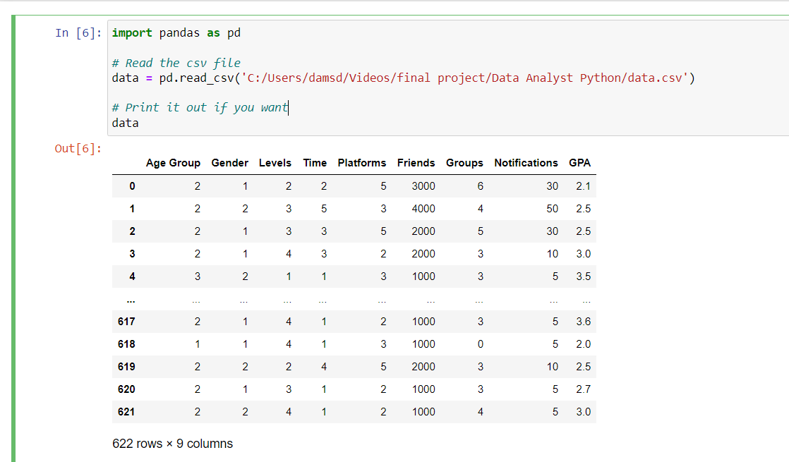
Age Group | 1: 20 years or below 2: [20, 30] 3: above 30 years
Gender | 1: Male 2: Female
Levels | 1: 100 level 2: 200 level 3: 300 level 4: 400 level
Time | Represents the number of hours students spend on social media. It ranges from 1 to 5, indicating different time intervals
Platforms | Indicates the number of social media platforms a student belongs to. It ranges from 1 to 6, representing different levels of engagement with social media

Slide 10
Name of Journals | Web of Science Core Collection
Computers & Operations Research | Science Citation Index Expanded
European Journal of Operational Research | Science Citation Index Expanded
IEEE Transactions on Cybernetics | Science Citation Index Expanded
JOURNAL OF KING SAUD UNIVERSITY-COMPUTER AND INFORMATION SCIENCES | Science Citation Index Expanded
COMPUTERS & INDUSTRIAL ENGINEERING | Science Citation Index Expanded
Friends | Represents the number of friends a student has on social media
Groups | Indicates the number of social media groups a student belongs to
Notifications | Represents the number of times a student checks notifications on social media daily
GPA | Grade Point Average of the student, which serves as a measure of their academic performance

Slide 11
V- Literature Review
The literature review supports the chosen methodology by highlighting the negative relationship between social media metrics and academic performance.
Existing research, such as the "Measuring the effect of social media on student academic performance using a social media influence factor model," emphasizes the significance of social media influence factors. This project extends this work by employing machine learning to provide a predictive understanding, aiming to contribute valuable insights to the existing body of knowledge.

Slide 12
2- Implementation Plan
I- Technology Stack
The project will be implemented using the following technologies and tools:
Programming Languages: Python
Libraries: Scikit-learn, Pandas, NumPy, Matplotlib, Seaborn
Frameworks: Flask (for deployment)
Other Tools: Jupyter Notebooks, Git (for version control)

Slide 13
2- Implementation Plan
II- Timeline
The timeline for the project is as follows:
Data Collection and Preprocessing:
Collect and clean data from the University Professional Studies of Accra.
Preprocess data, handle missing values, normalize features, and encode categorical variables.
Model Development:
Explore various machine learning algorithms suitable for predicting GPA.
Create additional features and explore the relationship between social media metrics and academic performance.

Slide 14
2- Implementation Plan
II- Timeline
Training and Evaluation:
Train machine learning models on the dataset.
Evaluate models using appropriate metrics (e.g., Mean Absolute Error, R-squared).
Deployment:
Develop a simple web application using Flask for model deployment.
Documentation and Finalization:
Document the entire project, including code comments and a README file.
Finalize the project for submission.

Slide 15
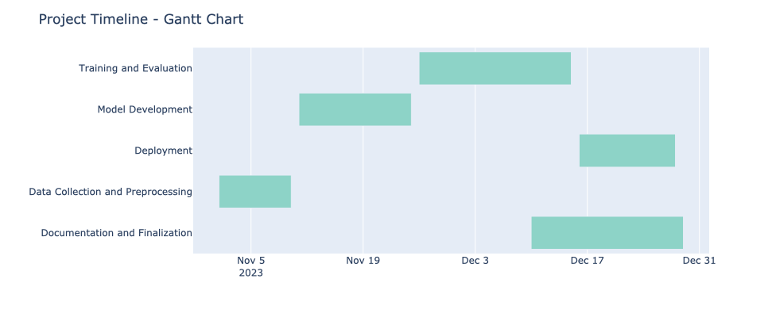
2- Implementation Plan
II- Timeline

Slide 16
III- Milestones
Milestone 1 (Week 1): Completion of data collection and preprocessing.
Milestone 2 (Week 2): Successful development and evaluation of machine learning models.
Milestone 3 (Week 3): Deployment of the model in a Flask web application.
Milestone 4 (Week 5): Submission of the finalized project with comprehensive documentation.

Slide 17
IV- Challenges and Migitations
Data Quality | Regularly check for inconsistencies and outliers. Use exploratory data analysis to identify and handle anomalies.
Model Performance | Experiment with various algorithms and hyperparameter tuning to enhance model performance.
Technical Constraints | Regularly update libraries and frameworks to avoid compatibility issues. Maintain a robust version control system.

Slide 18
V- Ethical Considerations
Considering the sensitive nature of academic and social media data, the project will prioritize:
Data Privacy: Ensure that collected data is anonymized and handled with strict privacy protocols.
Bias Mitigation: Regularly assess models for biases and take measures to mitigate any identified biases.
Community Impact: The project aims to positively impact the academic community by providing insights for better educational strategies.

Slide 19
VI- Conclusion
In conclusion, the combined insights from these studies emphasize the pervasive influence of social media on academic performance. The nuanced understanding of usage patterns and the quantification of this impact contribute significantly to our research objectives.
By synthesizing these findings, our project aims to provide a predictive model that incorporates insights from existing literature and addresses the specific challenges posed by social media usage among university students.
All sources, including the paper "Impact of Social Media on Students' Academic Performance: A Case Study of Islamic University, Bangladesh," and previously mentioned papers, have been diligently cited in adherence to academic standards.
Proper citations uphold the integrity of our literature review and acknowledge the valuable contributions of referenced works to the overarching research goals.

Slide 20
REFERENCES
https://doi.org/10.6084/m9.ﬁgshare.14905
https://www.researchgate.net/publication/362079186_Measuring_the_effect_of_social_media_on_student_academic_performance_using_a_social_media_influence_factor_model

Slide 21
TThank you

